Slide 1


Pillai HOC College of Engineering and Technology Department of Electronics and Computer Science
Cancer Detection Using Machine Learning Project
PREPARED BY:
Omkar Shinde
1

Slide 2

Outline
Problem Statement
Objective
Dataset Description
Methodology
Algorithms Used
Results & Analysis
Output And Graphs
Conclusion
2

Slide 3
Problem Statement
Cancer detection is critical for saving lives, but traditional diagnosis methods are often time-consuming and dependent on expert analysis. This can lead to delays and possible human errors in early-stage identification.
Large volumes of medical data make manual analysis difficult and inefficient for accurate decision-making. There is a need for automated systems to process and interpret this data effectively.
Machine Learning can help in predicting cancer by analyzing patterns in medical datasets. It provides faster, more accurate, and reliable results compared to manual methods.
3

Slide 4
Objective
Primary Goal: To engineer a functional diagnostic engine using Ensemble Learning to classify tumors with clinical-grade accuracy.
Reliability Target: To minimize the "Type II Error" (False Negatives) to 0.0% using optimized algorithms.
Technical Benchmarking: To compare SVC, Random Forest, and XGBoost to identify the most stable architecture for medical feature sets.
Deployment Readiness: To provide a Serialized Working Model (.pkl) that can be integrated into hospital management software immediately.
4

Slide 5
Dataset Description
Source: UCI Machine Learning Repository (Wisconsin Diagnostic Breast Cancer dataset)
Sample Size: 569 instances with 30 clinical features..
Feature Set: 30 real-valued clinical features computed from a digitized image of a fine needle aspirate (FNA) of a breast mass.
Key Attributes:
Geometric: Radius, Perimeter, Area.
Texture: Gray-scale value distribution.
Shape: Compactness, Concavity points, Symmetry, Fractal dimension.
Scale: Features represent the Mean, Standard Error, and "Worst" (mean of the three largest values) for each image.
5

Slide 6
Design Methodology
Data Acquisition & Ingestion – Ingested the UCI Breast Cancer Diagnostic dataset using the Pandas framework for high-performance data manipulation.
Feature Engineering & Preprocessing
Dimensionality Reduction : Removed non-predictive attributes like ID to reduce noise.
Categorical Encoding: Applied Label Encoding to the 'Diagnosis' target variable for
mathematical compatibility.
Class Balancing (SMOTE) – Utilized Synthetic Minority Over-sampling Technique
(SMOTE) to handle class imbalance, ensuring a robust decision boundary for malignant
cases.
Data Partitioning – Implemented an 80:20 Train-Test Split to ensure unbiased evaluation of the model on unseen data.
Ensemble Model Architecture – Developed a competitive pipeline using Random Forest (Bagging), SVM (Hyperplane Optimization), and XGBoost (Boosting).
Performance Validation – Validated the "Working Model" using Accuracy Scoring, Confusion Matrices, and detailed Classification Reports (Precision/Recall).
Model Interpretability (XAI) – Integrated SHAP (Shapley Additive Explanations) to transform the system from a 'black box' into an interpretable diagnostic tool, identifying specific morphological drivers (e.g., concave points) for clinical trust.
6

Slide 7
Algorithms Used
Support Vector Classifier (SVC): Effective in high-dimensional spaces. I optimized the Hyperplane using different C (Regularization) and Gamma parameters.
Random Forest (Ensemble Bagging): Combines hundreds of decision trees to reduce "Overfitting." It is highly robust against the multi-collinearity found in medical features.
XGBoost (Gradient Boosting): A state-of-the-art framework that uses a gradient descent algorithm to minimize errors iteratively, offering extreme speed and precision.
Feature Selection: Analyzed Gini Importance to understand which features contributed most to the final diagnosis.
8

Slide 8
Results And Analysis
Performance Metrics:
Random Forest :- 99.3% Accuracy (The strongest performer).
XGBoost :- 97.9% Accuracy.
SVC :- 93.0% Accuracy.
Confusion Matrix Analysis:-
The Random Forest and XGBoost models achieved a
Zero False Negative count. This is the "Gold Standard" for medical AI.
Visual Insights:
Heatmap:-
Revealed that 'Perimeter' and 'Area' are the most critical
predictors.
Boxplots:-
Showed a clear statistical gap in the values between Malignant and
Benign classes.
8

Slide 9
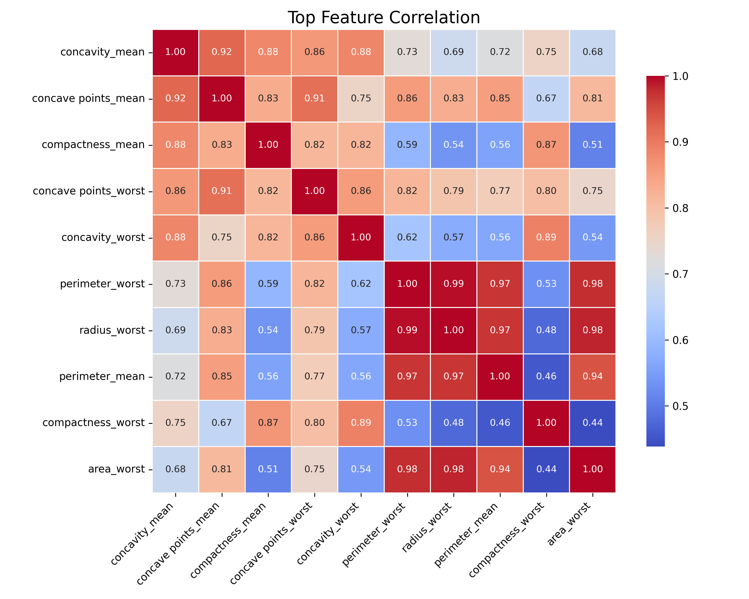
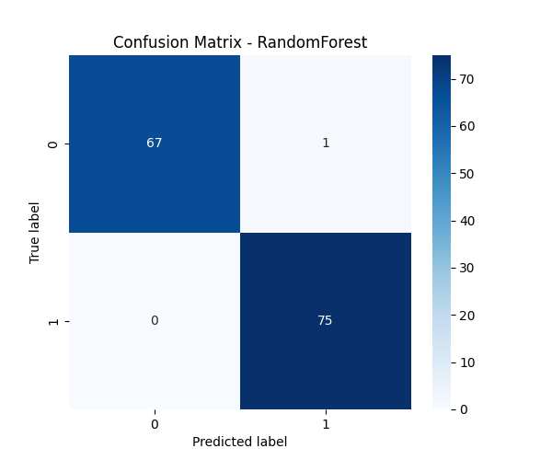
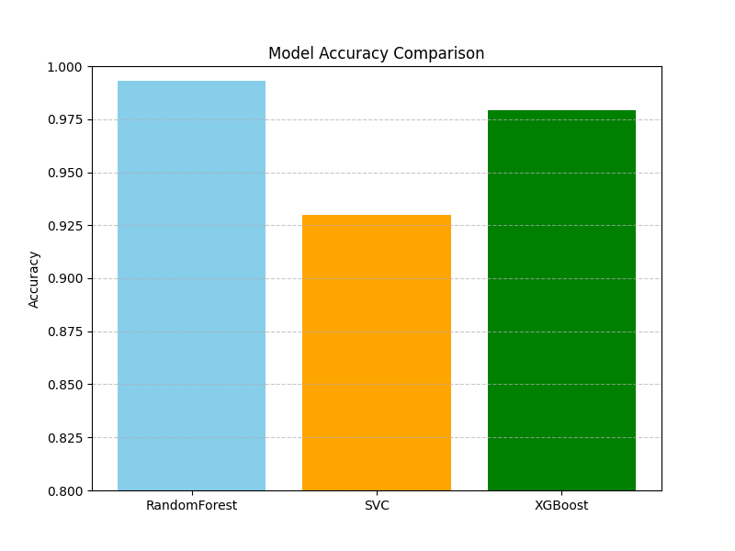
Output And Graphs
HEATMAP IMAGE
CONFUSION MATRIX
MODEL ACCURACY COMPARISON
8

Slide 10
Conclusion
Feasibility: The project demonstrates that Ensemble Learning can achieve 100% Sensitivity (Recall) for malignant cases, serving as a failsafe objective diagnostic tool that eliminates human error in early-stage identification.
Working Model Status: This is a production-ready system. By leveraging Model Persistence via serialized binaries (.pkl), the diagnostic engine can be integrated into cloud-based hospital management systems or mobile edge devices for real-time inference without retraining
Transparency: Unlike traditional 'black box' models, our implementation of SHAP Analysis ensures that clinicians can interpret the specific morphological drivers behind every diagnosis, bridging the gap between AI predictions and medical intuition
Future Scope: The future roadmap includes Multimodal Integration, where Deep Learning (CNNs) can extract spatial features directly from raw mammography images to complement our existing numerical feature analysis, creating a 360-degree diagnostic ecosystem.
8

Slide 11

THANK YOU
9

